Slide 1

Cognitive Computing
Dr. Piyush Joshi
Assistant Professor
IIIT Sri City

Slide 2
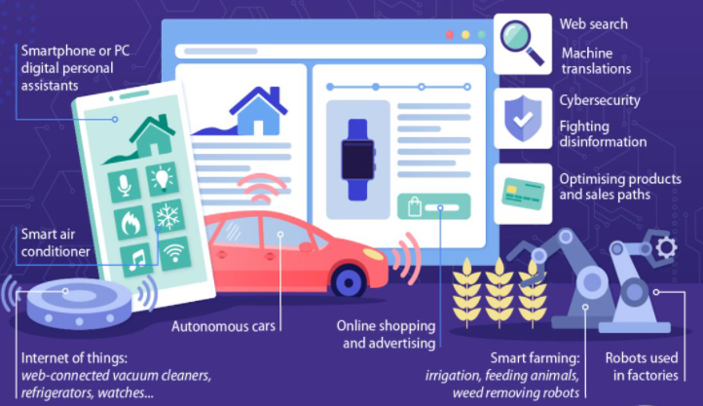
AI but not Real AI
Current AI not follow what the original field was supposed to be about…..

Slide 3
AI but not Real AI
We do not have flexible general-purpose notion of intelligence.
We can do many things but why AI is specific.
Where is the gap?

Slide 4
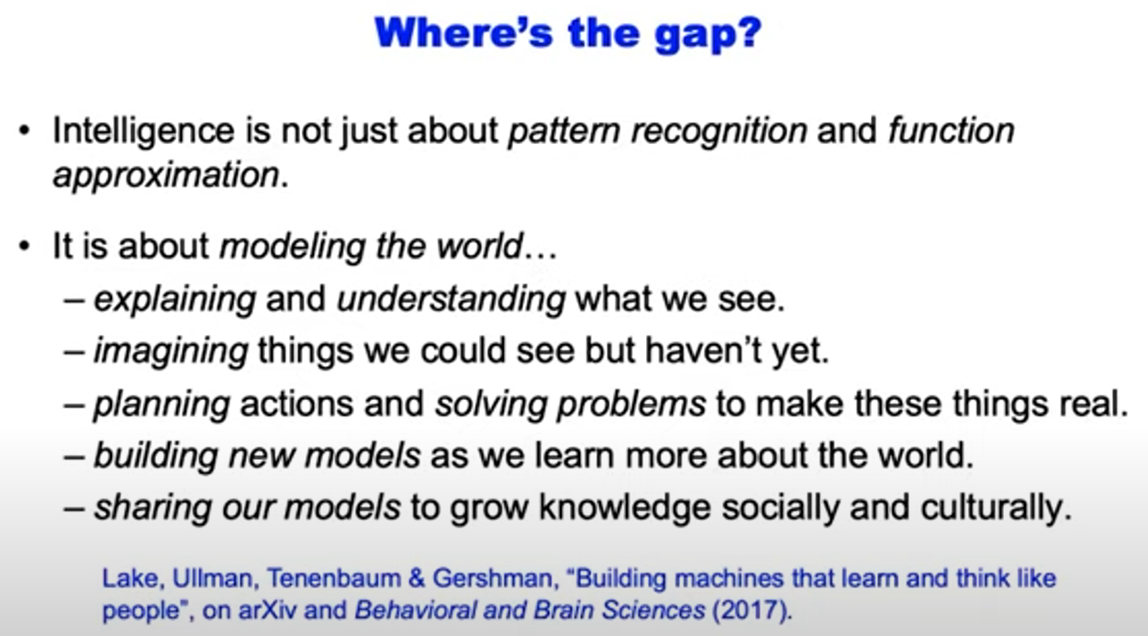

Slide 5
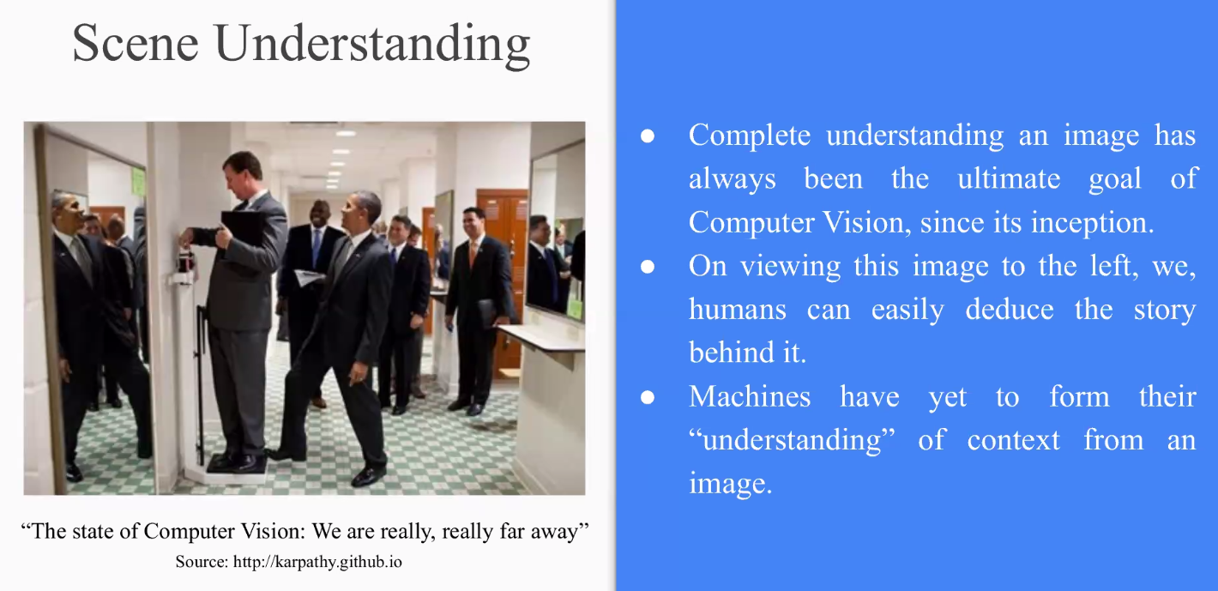

Slide 6
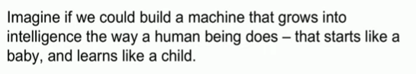
Intelligent ?

Slide 7
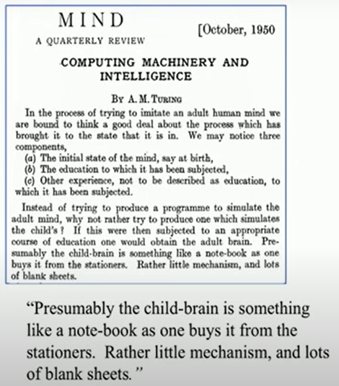
Intelligent by Alan Turing

Slide 8
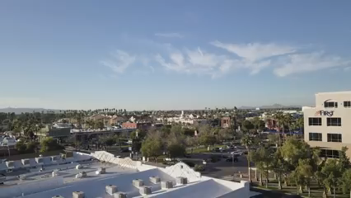
Really cars learning ?
We have big name self-driving cars such as Tesla, Waymo etc.
Waymo taxi available in phoenix.

Slide 9
Self-driving cars
Two things are very important:
1) How much has been invested in building these cars
2) How far we are from actual full self-driving cars- like humans do
An article in wall street journal on business side:
$100 billion investment
We are far from the end
People are working in industry for at least 15 years
And in academia since 80s

Slide 10
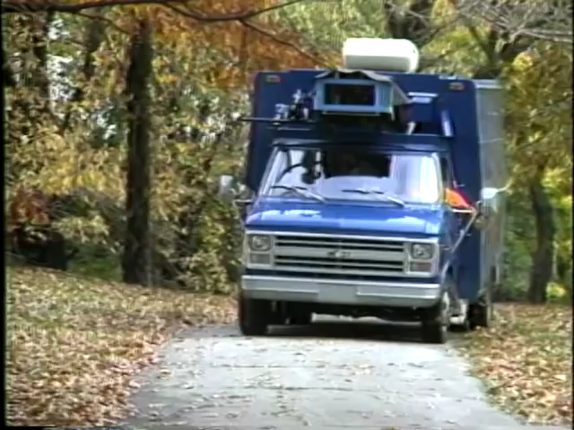
CMU: Self-driving cars
Mid 80s: CMU built self-driving car
This car is guided by as simple neural network.
So porotype you see today have existed for many year.

Slide 11
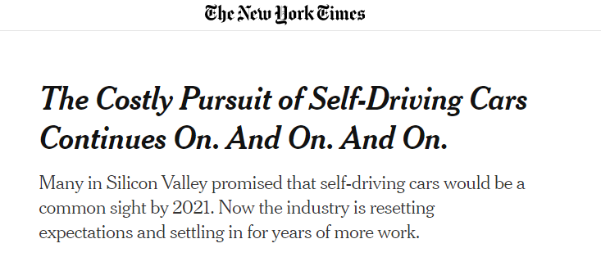
Current status of Self-driving cars
Still despite many years, $100 billion and work by world’s greatest engineering company like Google and Tesla
We are still far from having complete solution to full self-driving car (like human do).

Slide 12
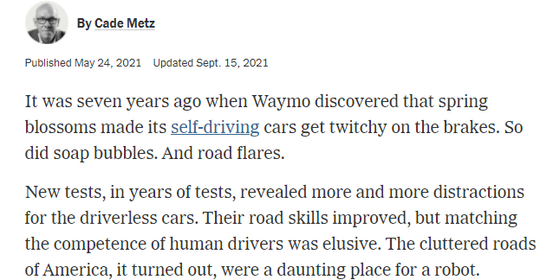
Current status of Self-driving cars

Slide 13
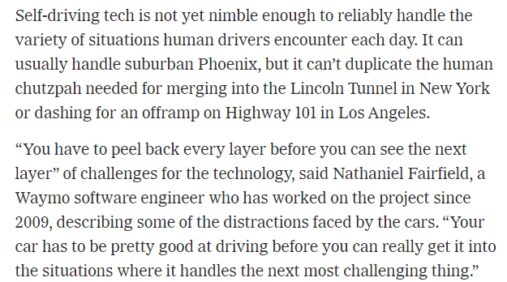
Current status of Self-driving cars

Slide 14
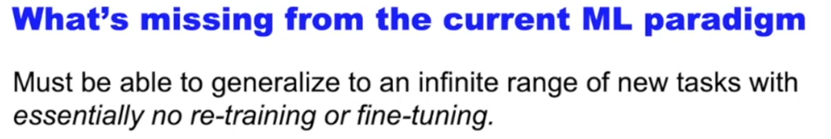

Slide 15
The common-sense core

Slide 16
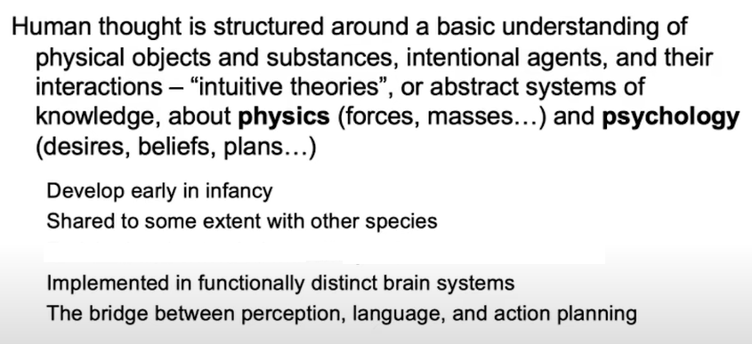
The common-sense core

Slide 17
Intuitive Physics: common-sense

Slide 18
Common-sense

Slide 19
Common-sense

Slide 20
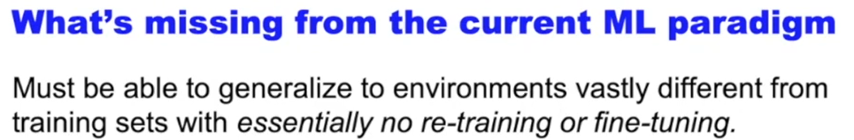
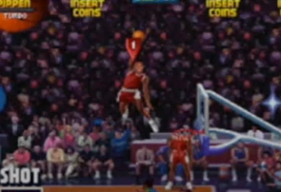
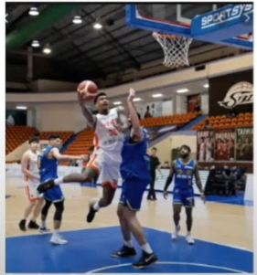
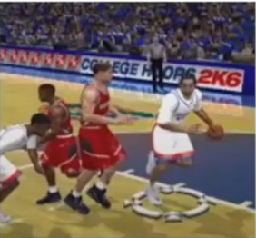
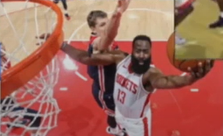
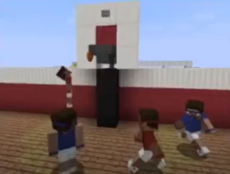

Slide 21
Reverse Engineering

Slide 22
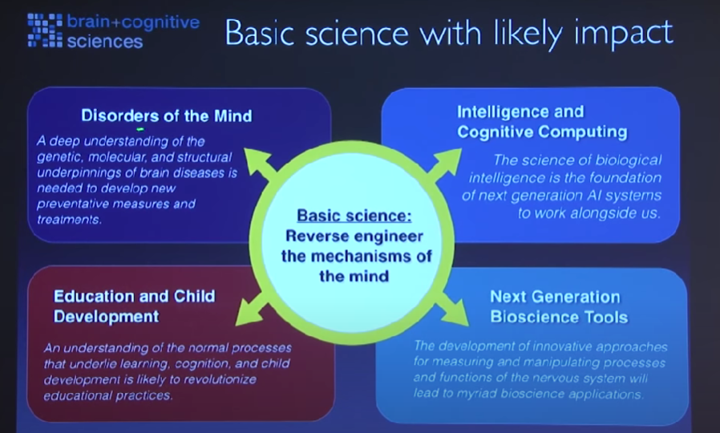

Slide 23
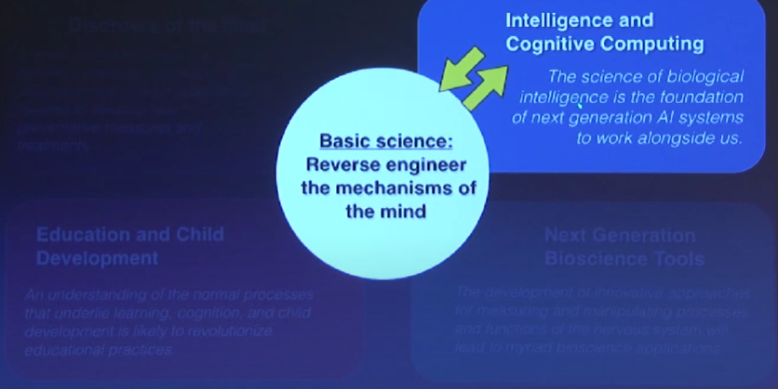

Slide 24
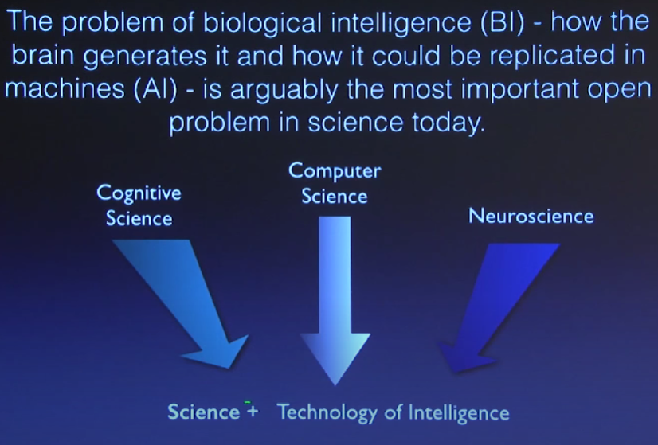

Slide 25
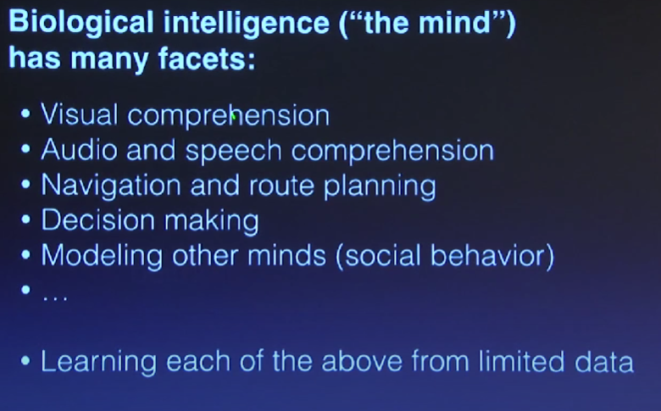

Slide 26
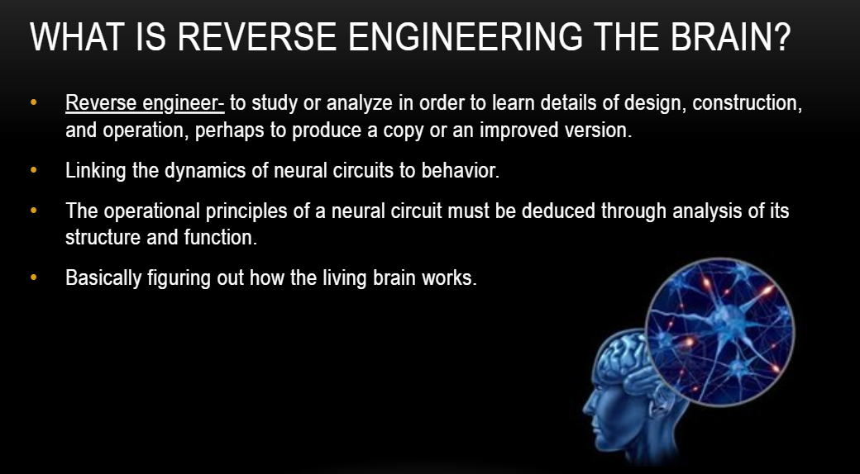

Slide 27
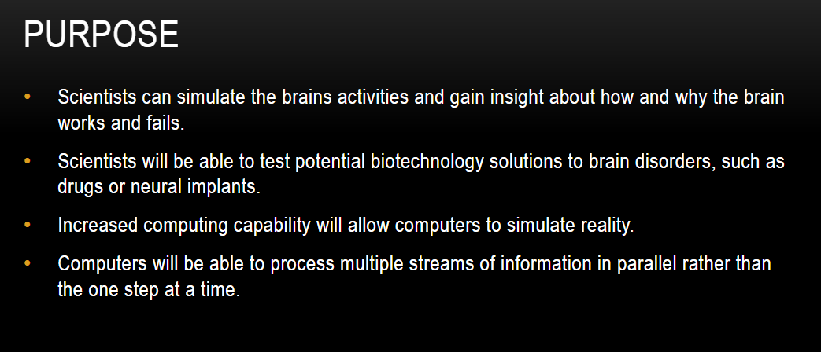

Slide 28
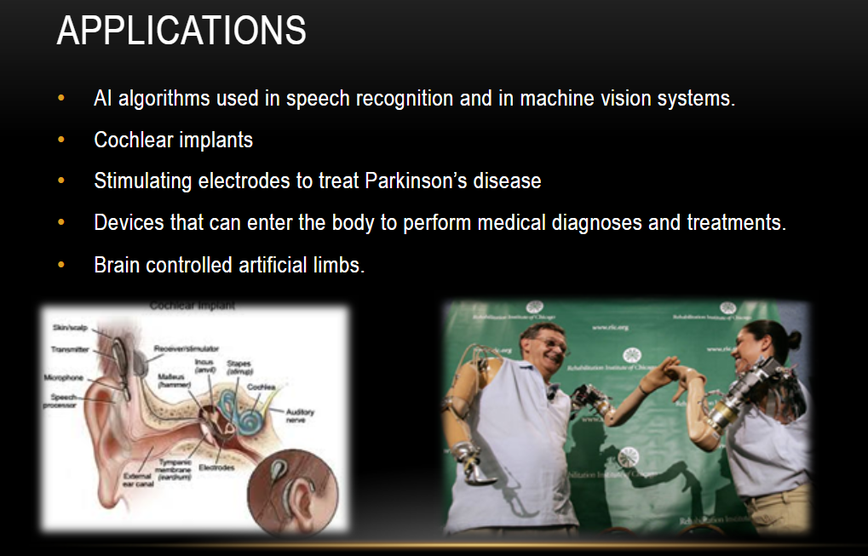

Slide 29
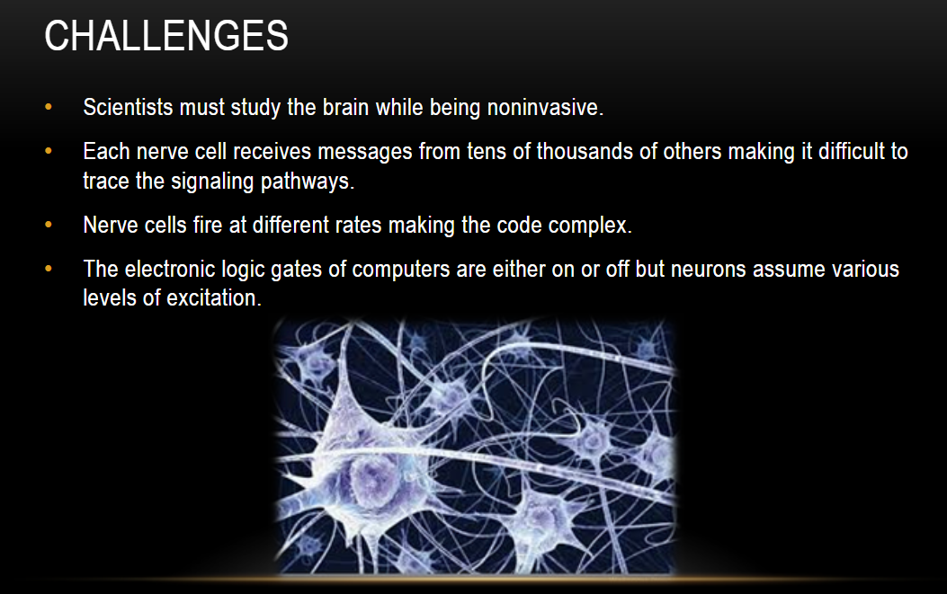

Slide 30
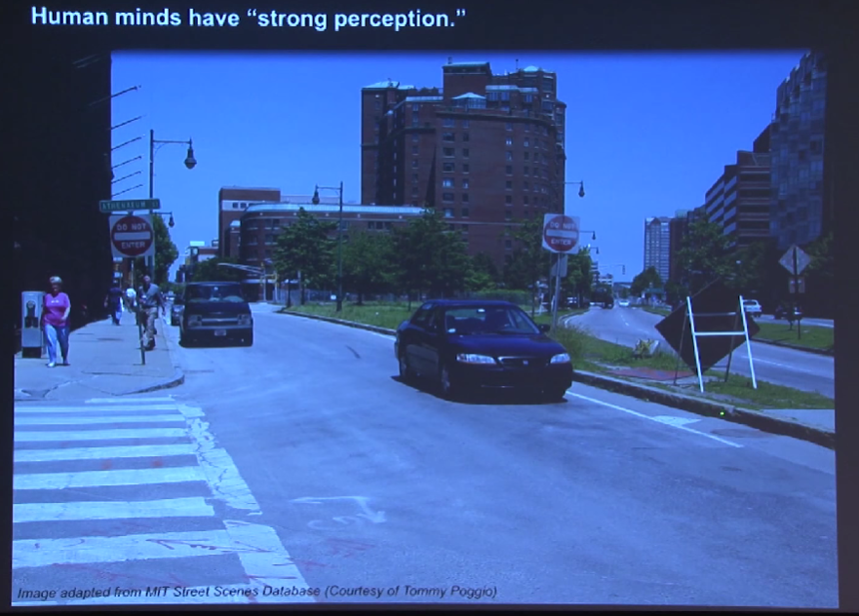

Slide 31
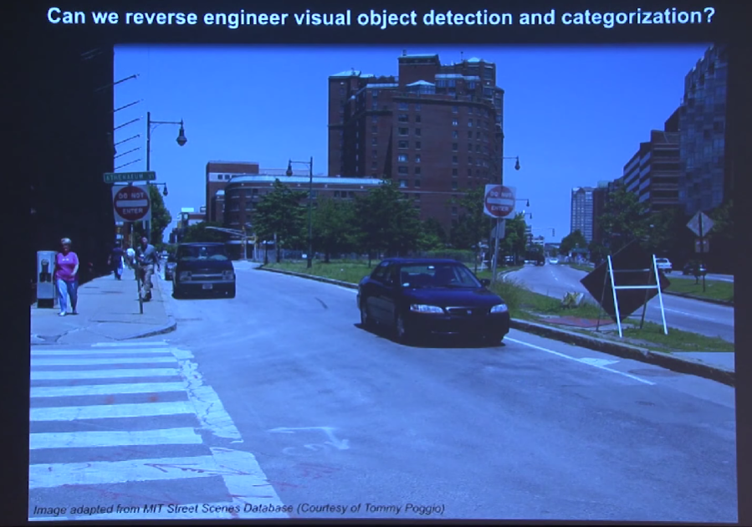

Slide 32
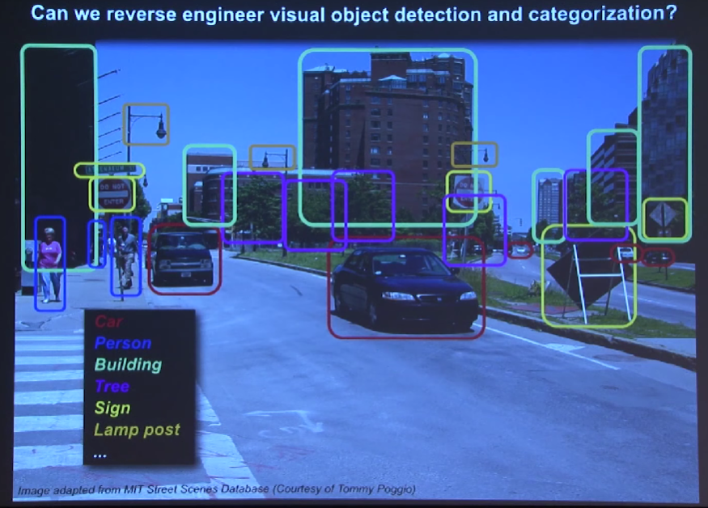

Slide 33
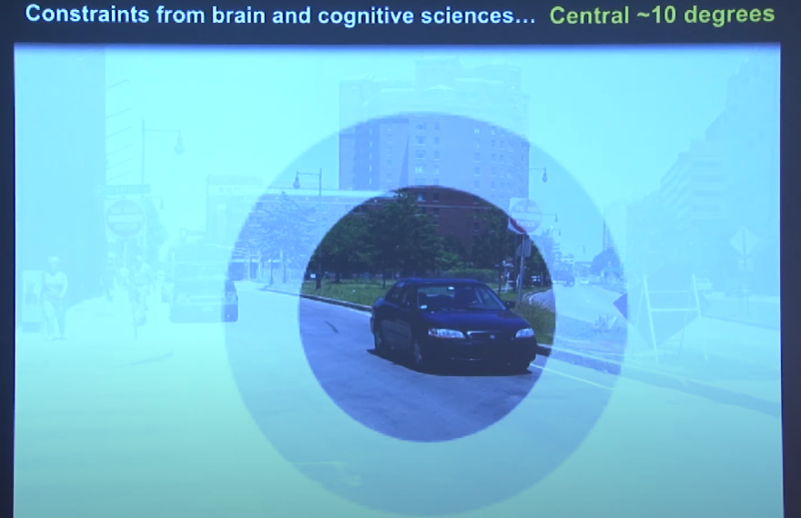
Brain does not process whole image at once

Slide 34
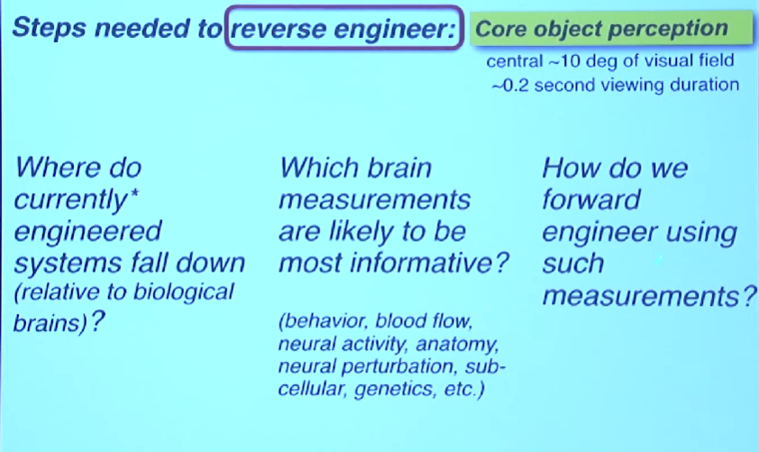

Slide 35
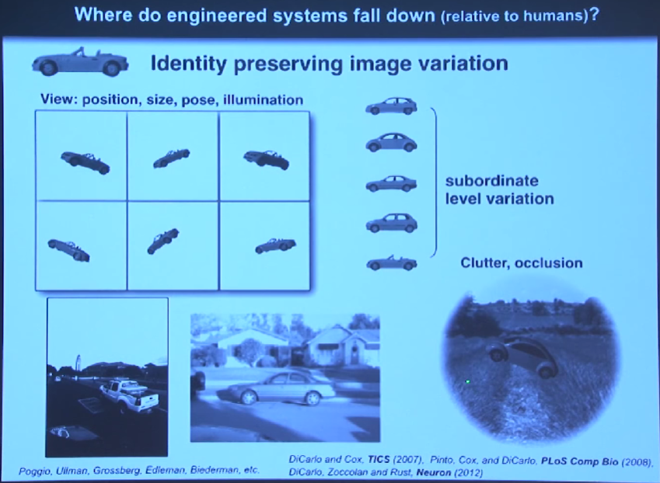

Slide 36
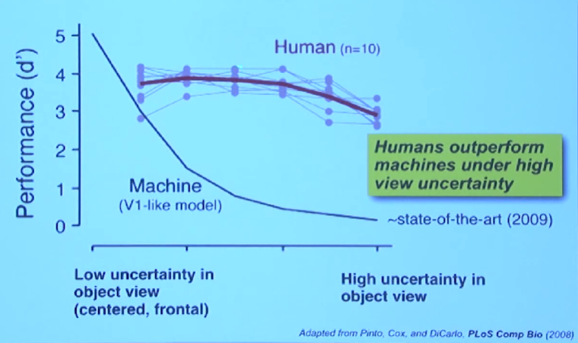

Slide 37
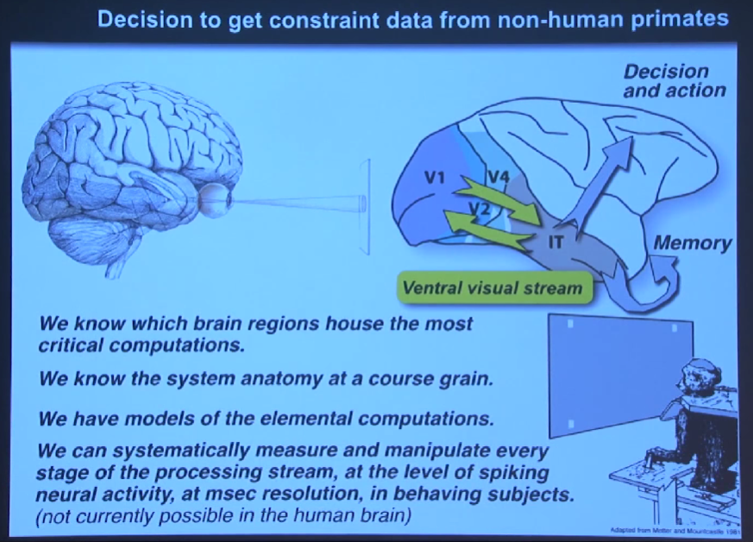

Slide 38
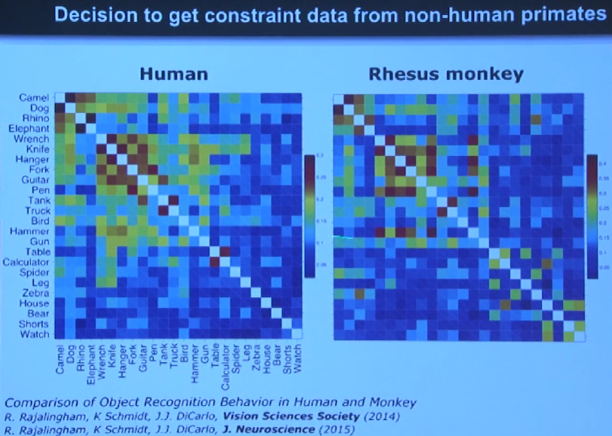

Slide 40
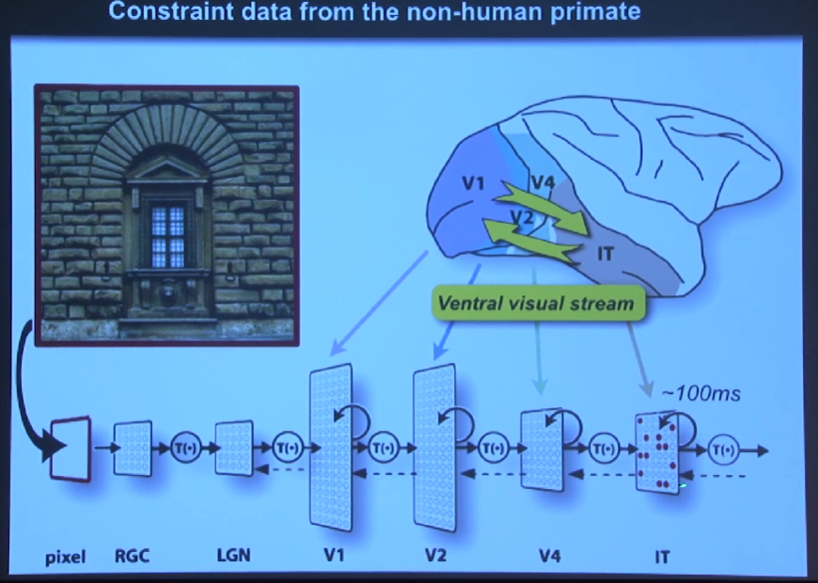
retinal ganglion cells lateral geniculate nucleus inferior temporal

Slide 41
Its not photograph, its new pattern of neural activities that is evoked by an image.

Slide 42
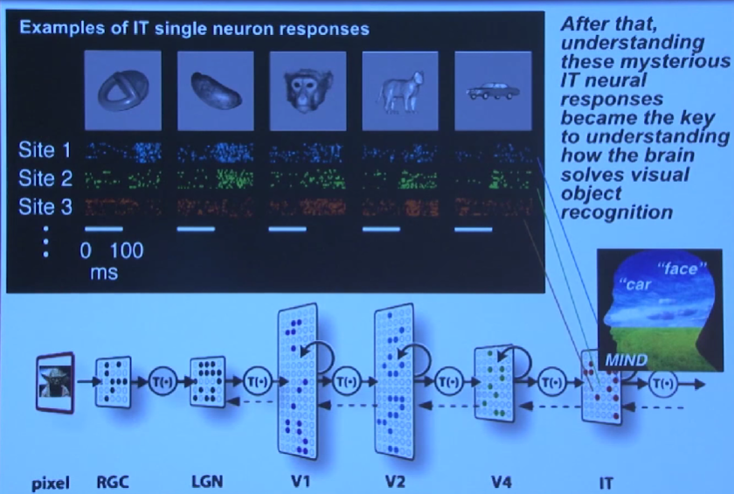

Slide 43
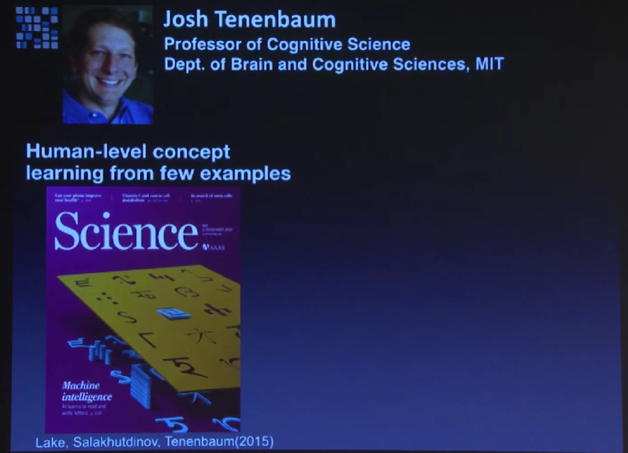
They built a system that learn from just a few examples

Slide 44
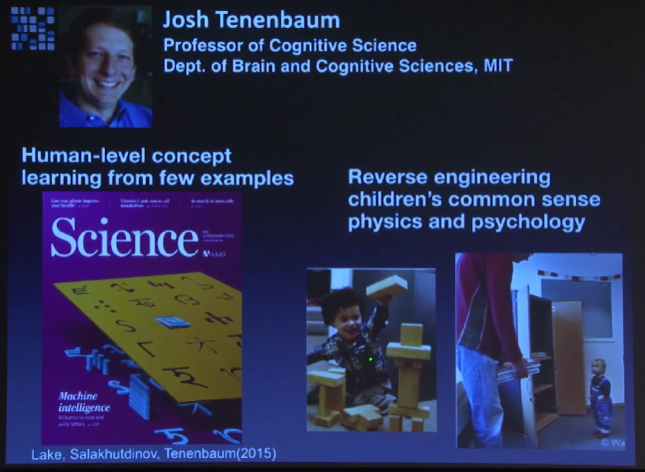

Slide 45
Reverse-engineering: Core Cognition

Slide 46
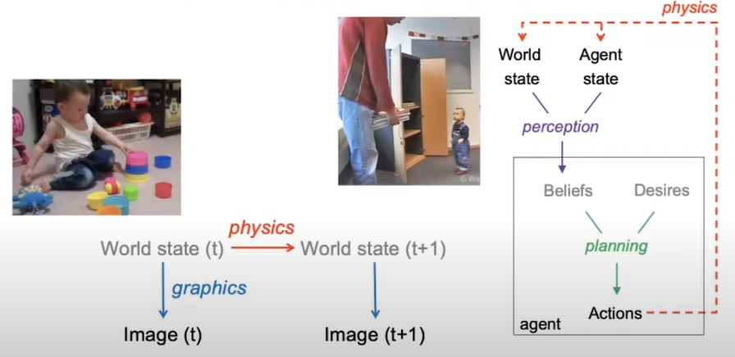
Reverse-engineering: Core Cognition

Slide 47
How to build this architecture?
Probabilistic program integrate our best ideas on intelligence, across different eras of AI:
Symbolic Manipulations : for representing and reasoning with knowledge base
Bayesian Inference : for reasoning of unobserved causes from uncertain data
Neural Network : for pattern recognition and function appx.

Slide 48
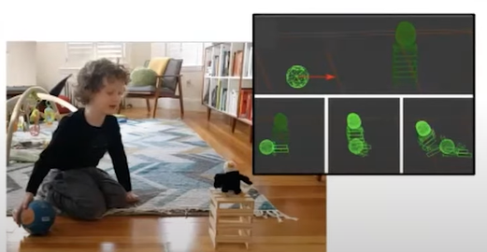
How to build this architecture?
Game engine in our head:
Very fast program to simulate graphics, physics and planning

Slide 49
